Slide 1
Module 2: RELATIONAL ALGEBRA

Slide 2
Content
Query languages & Formal query languages for Relational data model
Introduction to Relational Algebra
Relational operators
Set operators
Join operators
Aggregate functions
Grouping operator

Slide 3
Relational Algebra
Relational Algebra is a formal query language for relational data model.
A basic set of relational model operations constitute the relational algebra.
These operations enable the user to specify basic data retrieval requests.
The result of a relational algebra query is also a new relation which may have been formed from one or more relations.
A sequence of relational algebraic operations forms a relational algebraic expression, whose result is also a relation.

Slide 4
Contd…
Procedural language
Six basic operators
Select : σ
Project : ∏
Union : ∪
set difference: –
Cartesian product: x
Division : ÷
Rename : ρ
The operators take one or two relations as inputs and produce a new relation as a result.

Slide 5
Operations in Relational Algebra
Set Operations
Union
Intersection
Difference
Cartesian product
Relational Operations
Select
Project
Join
Division, etc.

Slide 6
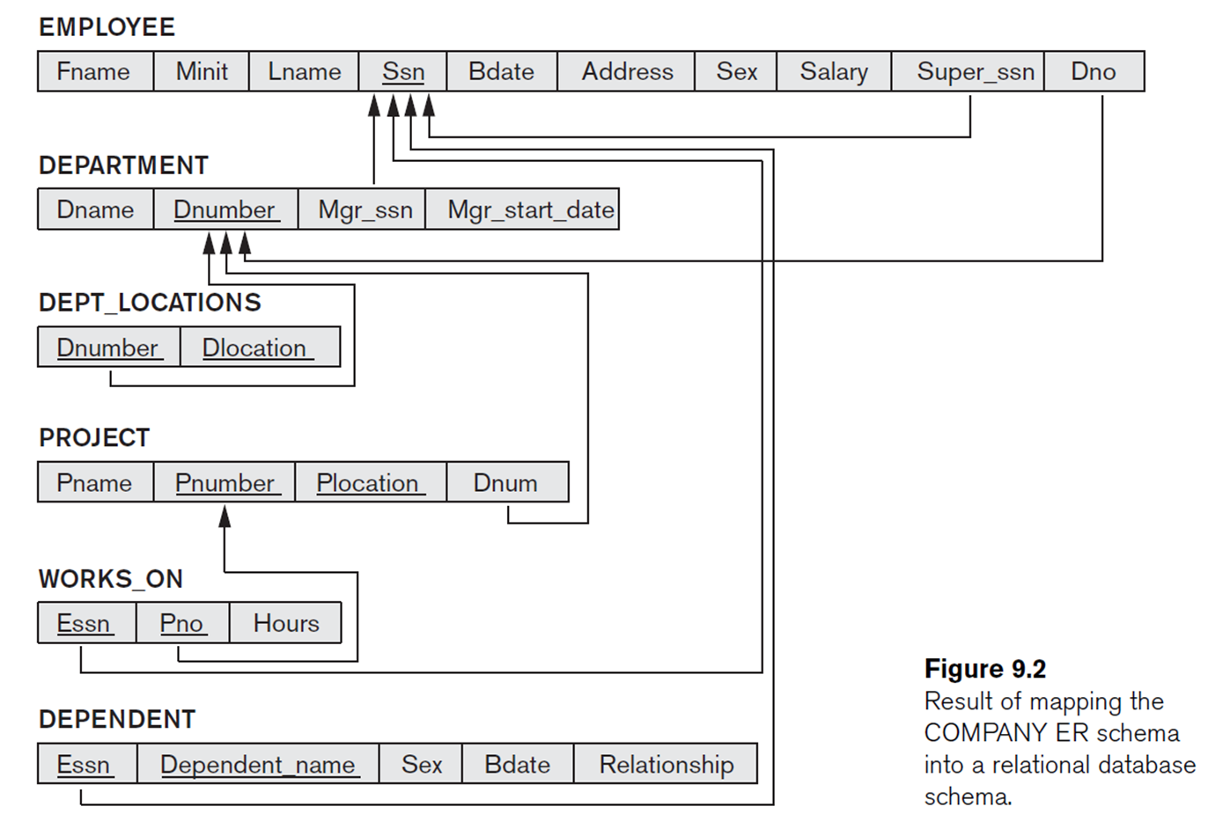
Sample Schema
Employee
Department
Project
Notes:
The examples given for each operation is based on this schema diagram.

Slide 7
Select Operation
The select operation retrieves a subset of tuples in a relation that satisfy a selection condition.
σ_{<selection-condition>} (Relation)
Query-1: Find the employees whose salary is greater than $1000.
σ_{Salary > 1000} (Employee)
Query-2: Find the employees who work for department 30 and whose salary is greater than $3000.
Emp30 ← σ_{DNo = 30} (Employee)
Result ← σ_{Salary > 3000} (Emp30)
Or,
Result ← σ_{DNo = 30 and Salary > 3000} (Employee)

Slide 8
Project Operation
The projection operation is used to select only few columns from a relation. π_{<attributes>} (Relation)
Query-5: List the name and salary of all the employees.
π_{FName, Salary} (Employee)
Query-6: Print the project name and their locations.
π_{PName, PLocation} (Project)
Query -7: Retrieve the Name and Salary of all employees working for department 10.
Result ← π_{FName, Salary} (σ_{DNo = 10} (Employee))

Slide 9
Project Operation…
Query-8: Find the name, address, and salary of the employees who earn more than 25000 rupees.
π_{FName, Salary, Address} (σ_{Salary > 25000} (Employee))
Query-9: List the name and the location of the projects not controlled by department 2.
π_{PName, PLocation} (σ_{Dnum ≠ 2}) (Project))

Slide 10
Union Operation
The result of this operation, i.e. R ∪ S, is a relation that includes all tuples that are either in R or in S or in both. Duplicate tuples will not appear in the output.
Union Compatibility: Let R and S are two relations with attributes (A1, A2, …, An) and (B1, B2, ….., Bn) respectively. If R and S are to be unioned, it should satisfy the following two rules:
Rule 1: The relations R and S must have the same degree. That is, the number of attributes of R and S must be same.
Rule 2: The domain of the ith attribute of R and the domain of the ith attribute of S must be same.
dom(Ai) = dom(Bi), where, 1 ≤ i ≤ n.

Slide 11

Union Operation – Example 1
Query-10: Retrieve the SSN of all employees who either work in department 30 or directly supervise an employee who works in 30.
Emp_Dept30 ← π_{SSN} (σ_{DNo = 30} (Employee))
Supervisors ← π_{Super_SSN} (σ_{DNo = 30} (Employee))
Result ← Emp_Dept30 ∪ Supervisors
Emp_Dept3 Supervisors Result
∪

Slide 12
Union Operation – Example 2

Slide 13

Set-Intersection Operation
The expression R ∩ S returns all tuples that appear in both the relations R and S.
Query-12: Find the first name and the last name of people who are teachers as well as students.
Student ∩ Teacher

Slide 14


Set Difference Operation
This operation, written as R – S (set difference) returns all tuples that are in R but not in S.
Query-13: Find the students who are not teachers.
Result ← Student – Teacher
Query-14: Find the teachers who are not students.
Result ← Teacher – Student

Slide 15
Cartesian-Product Operation
The Cartesian product or cross-product is a binary operation that is used to combine two relations. Assuming R and S as relations with n and m attributes respectively, the Cartesian product, R × S can be written as,
R (A1, A2, …, An) × S (B1, B2, …, Bm)
The result of the above set operation is,
Q (A1, A2, …, An, B1, B2, …, Bm)
Where,
Degree (Q) = n + m
count(Q) = Number of tuples in R * Number of tuples in S.

Slide 16

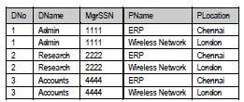
Cartesian-Product Operation Example
DeptProj ← Department × Project

Slide 17
Cartesian-Product Operation Query
Query-15: Find for each female employee, all the names of her dependents.
FemaleEmp ← π_{SSN, FName} (σ_{Sex = ‘F’} (Employee))
FemaleDeps ← FemaleEmp × Dependent
Result ← π_{Name, Dependent_Name} (σ_{Employee.SSN = Dependent.ESSN} (FemaleDeps))

Slide 18
Rename Operation
We can rename either the relation name or the attribute names, or both—as a unary operator.
The general RENAME operation when applied to a relation R of degree n is denoted by any of the following three forms:
ρ_{S(B1, B2, ... , Bn)}(R) renames both the relation and its attributes
ρ_{S}(R) renames the relation only
ρ_{(B1, B2, ... , Bn)}(R) renames the attributes only
If the attributes of R are (A1, A2, … , An) in that order, then each A_{i} is renamed as B_{i}.

Slide 19
Division Operator
Consider two relations R and S. Assume that R has only two attributes r1 and r2 and S has only one attribute r2 with the same domain as in R. This is to ensure that the degree of the numerator is more than the degree of the denominator.
Now we shall define R/S as,
For each r1 value in R, consider the set of r2 values that appear in tuples of R with that r2 value. If this set contains S, the r1 is in the result of R/S.
One possible restriction in this definition is that every attribute in S should be in R.
Alternatively, we can define R/S as,
For, R(a1, a2, …., an, b1, b2, …., bn) / S(b1, b2, …., bn) and T = πa1, a2, …., an (R), return the subset of T, say W, such that every tuple in W × S is in R. W is the largest subset of T, such that,
(W × S) ⊆ R

Slide 20
Division Operator – Example 1
TRANSACTION
C# | P# | DATE | QTY
1 | P1 | 01-07-18 | 2
1 | P2 | 11-07-18 | 3
2 | P1 | 12-07-18 | 1
3 | P2 | 12-07-18 | 4
PRODUCT
P# | PNAME | PRICE | CAT
P1 | iPHONE | 60000 | E
P2 | SHOE | 3000 | F
"Get the customers who bought every product type that the company sells"
TX
C# | P#
1 | P1
1 | P2
2 | P1
3 | P2
PR
P#
P1
P2
TX/PR
C#
1

Slide 21
Division Operator – Example 2
OPTION
USN | SUBCODE
412 | CS175
412 | CS272
412 | CS351
413 | CS175
413 | CS272
532 | CS175
676 | CS272
ELECTIVE1
SUBCODE
CS175
CS272
ELECTIVE2
SUBCODE
CS175
ELECTIVE3
SUBCODE
CS175
CS272
CS351
OPTION/ELECTIVE1
USN
412
413
OPTION/ELECTIVE2
USN
412
413
532
OPTION/ELECTIVE3
USN
412

Slide 22
Join Operator
Join operation is essentially a cartesian product followed by a selection criterion.
Join operation denoted by ⋈.
JOIN operation also allows joining variously related tuples from different relations.

Slide 23
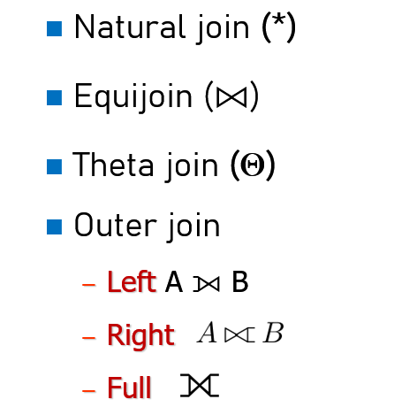
Types of JOIN

Slide 24
Natural Join (*)
When we omit the condition during joining of two relations, then it is called as natural join (*). When we use the word join, it invariably means natural join. We shall formally define natural join as:
Let R and S are the two relations with the attributes as shown below:
R(X1, X2, .., Xm, Y1, Y2, …, Yn) and
S(Y1, Y2, …, Yn , Z1, Z2, …, ZP)
Example:
Employees (SSN, Name, Addr, DNo)
Departments (DNumber, DName)

Slide 25
Theta Join
Let R and S are two relations. Consider an attribute x in R, and an attribute y in S. The theta join of these two relations can be written as,
R × S where x Θ y
where Θ indicates a valid relational operator.

Slide 26
Equi Join
The most widely used join operation is equijoin. As discussed in the previous subsection, when Θ is =, this type of Θ-join (a special case) is called equijoin.
We shall use the notation to denote equijoin. The general form for this kind of join is,
R ⨝ _{<Join_condition>} S
<Join_condition> must always have = operator

Slide 27
Examples
Query-16: Retrieve the name and salary of the manager of each department.
Managers ← Departments ⨝ Employees.SSN = Departments.SSN Employees
MgrNames ← π_{Name, Salary} (Managers)
Query-17: Find which project(s) and location(s) Pooja is working on.
EmpPooja ← σ_{Name = 'Pooja'} (Employees)
PoojaPrj ← EmpPooja ⨝ _{EmpPooja.SSN = WorksOn.SSN} WorksOn
Result ← π _{Name, PName, PLocation} (PoojaPrj ⨝ _{WorksOn.PNo = Projects.PNo} Projects)
WorksOn(SSN, PNo, Hours)

Slide 28
Outer Join
Dangling tuples in Join
Usually, only a subset of tuples of each relation will actually participate in a join, i.e. only tuples that match with the joining attributes.
Tuples of a relation not participating in a join are called dangling tuples.
How do we keep dangling tuples in the result of a join? Use null values to indicate a no-join situation. There are three types of outer joins
- left outer join
- right outer join and
- outer join (full outer join)

Slide 29

Contd…
Left outer-join
R1 ⟕ R2 is similar to a natural join but keep all dangling tuples of R1.
Right Outer-Join
R1 ⟖ R2 is similar to a natural join but keep all dangling tuples of R2.
Outer Join (full outer-join)
R1 ⟗ R2 is similar to a natural join but keep all dangling tuples of both R1 and R2.
The advantages of outer join is to take the union of tuples from two relations that are not union compatible.

Slide 30
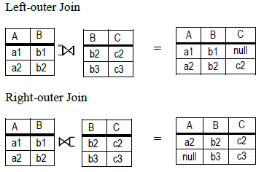
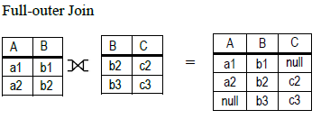
Example-1

Slide 31
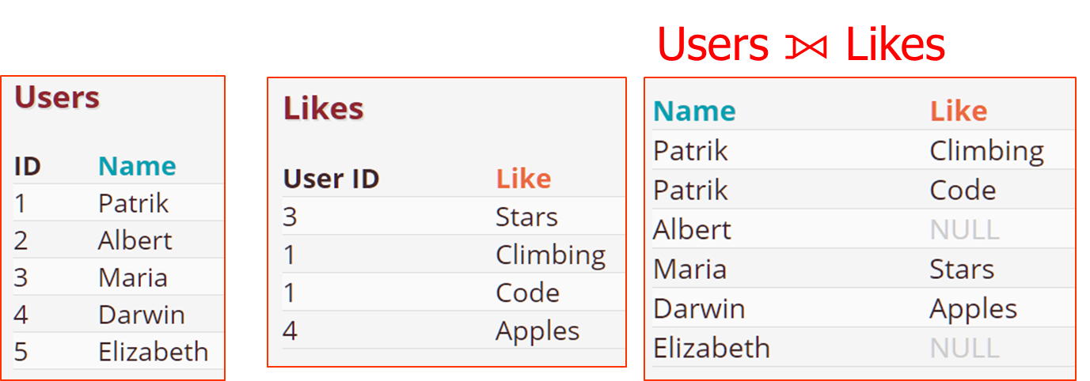
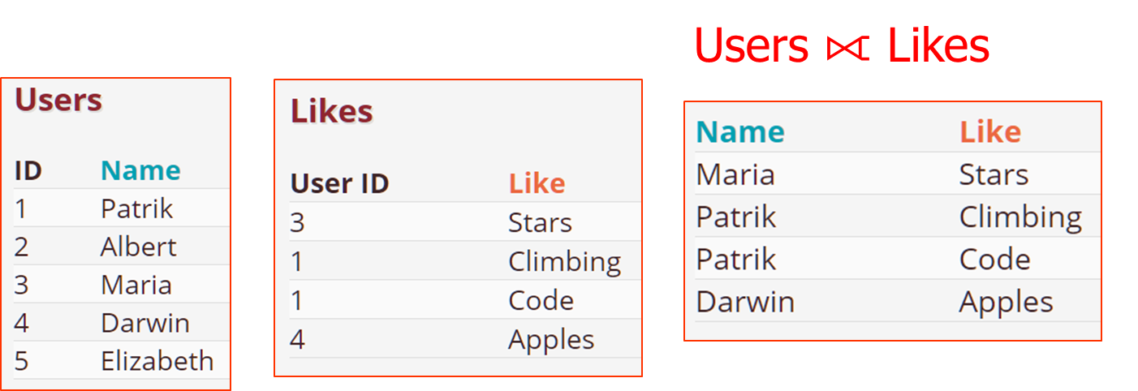
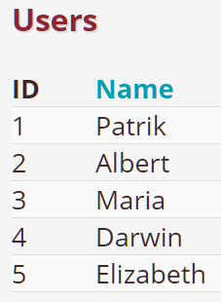
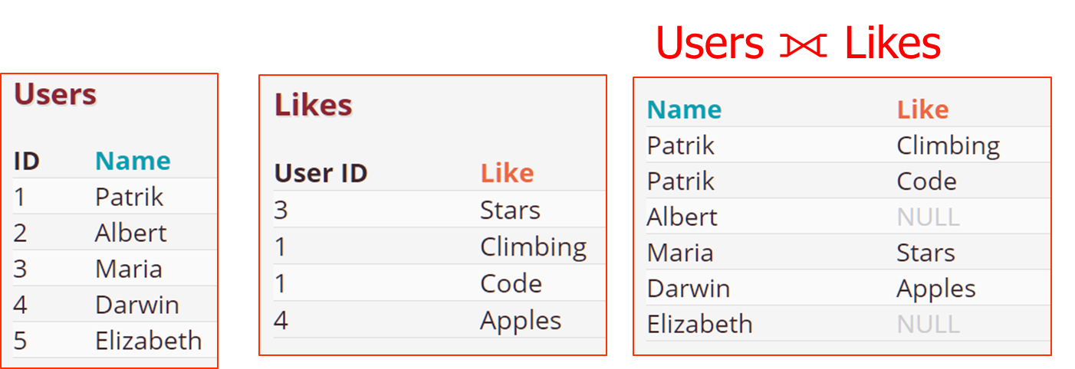
Example 2

Slide 32
Grouping & Aggregate Functions
We shall define Function formally using the symbol ℑ (pronounced as script F ) as,
_{grouping_attributes} ℑ _{aggregate_functions} (Relation)
The steps involved in the evaluation of this function is,
Partition the relation into groups.
Apply aggregate function to each group.
Output group and aggregate values, one tuple per group.

Slide 33
Example
Query-18: Retrieve department number, number of employees and their average salary.
Result (DNo, N, AvgSal) ← _{DNo} ℑ _{Count(SSN), Avg(Salary)} (Employees)
What happens when grouping attribute is dropped?
ℑ _{Count(SSN), Avg(Salary)} (Employees)

Slide 34
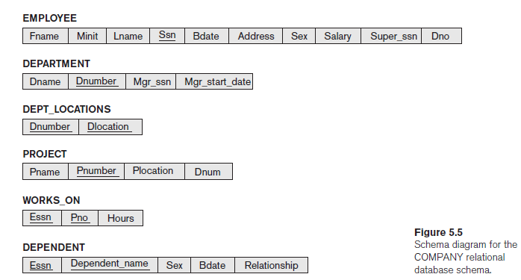
Company Database

Slide 35

Examples
Retrieve the first name, last name, and salary of all employees who work in department number 5.
π_{Fname, Lname, Salary}(σ_{Dno=5}(EMPLOYEE))
Or

Slide 36

Contd…
Retrieve the name of the manager of each department.

Slide 37
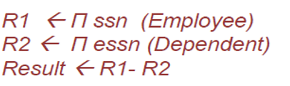
Contd…
3. Get the list of employee SSNs who have no dependents.
It is equivalent to: { {set of all employees} - {set of employees with Dependents} }

Slide 38
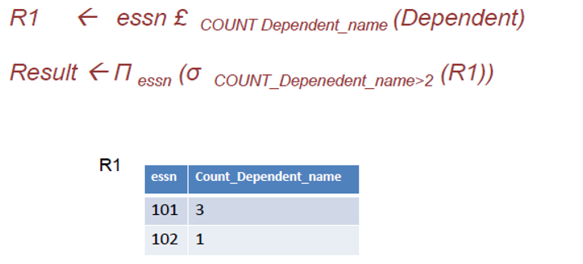
Contd…
4. Get the list of employee SSNs who have more than two dependents.

Slide 39
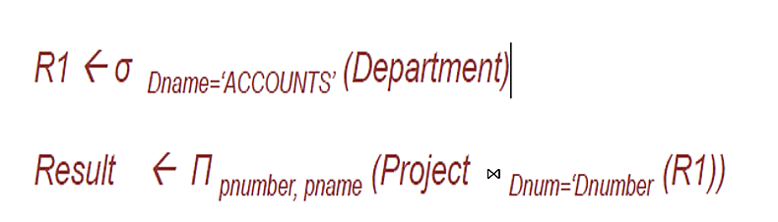
Contd…
5. Get the list of projects controlled by department with name “ACCOUNTS”

Slide 40
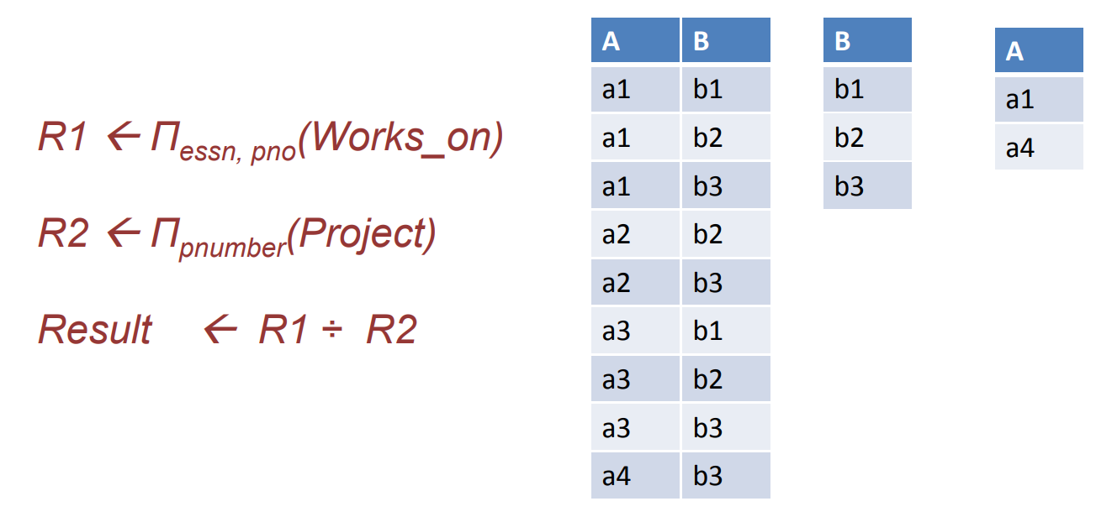
Contd…
6. Get the list of employee SSNs working on all projects.

Slide 41
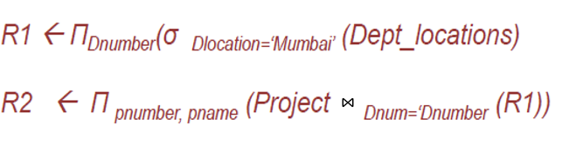
Contd…
7. Find the projects controlled by departments located in Mumbai

Slide 42
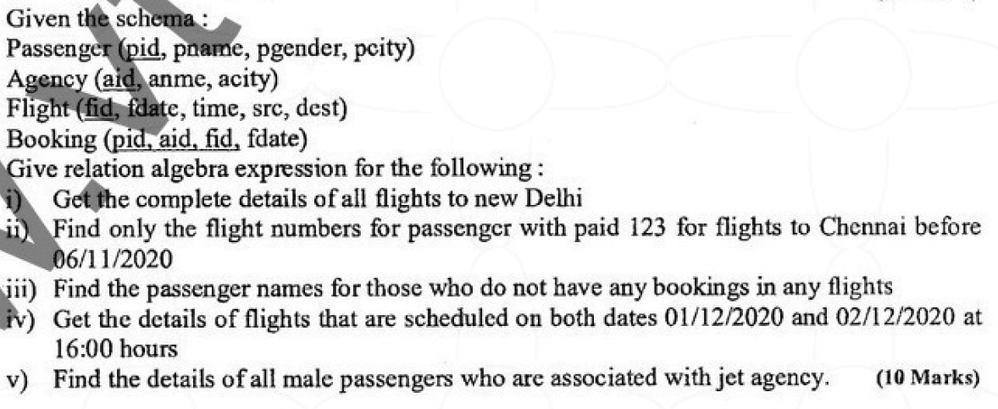
VTU QP Feb 2021
Passenger(pid, pname, pgender, pcity)
Agency(aid, aname, acity,
Flight(fid, fdate, time, src, dest)
Booking(pid, aid, fid, fdate)
Give relational algebraic expression for the following:
Give complete details of all flights to New Delhi.
Find only the flight numbers for passenger with pid 123 for flights to Chennai before 06/11/2020.
Find the passenger names for those who do not have any bookings in any flights.
Get the details of flights that are scheduled on both dates 01/12/2020 and 02/12/2020 at 16:00 hours.
Find the details of all male passengers who are associated with Jet agency.

Slide 43
Solution – Q1
Passenger(pid, pname, pgender, pcity)
Agency(aid, aname, acity,
Flight(fid, fdate, time, src, dest)
Booking(pid, aid, fid, fdate)
Give complete details of all flights to New Delhi.
Result ← σ_{dest = “New Delhi”} (Flight)

Slide 44
Solution – Q2
Passenger(pid, pname, pgender, pcity)
Agency(aid, aname, acity,
Flight(fid, fdate, time, src, dest)
Booking(pid, aid, fid, fdate)
(ii) Find only the flight numbers for passenger with pid 123 for flights to Chennai before 06/11/2020
ChennaiFlights ← σdest = “Chennai” ^ fdate < 06/11/2020 (Flight)
Passenger123 ← σ_{pid = 123} (Booking)
Result ← π_{fid} (Passenger123 ⨝ ChennaiFlights)

Slide 45
Solution – Q3
Passenger(pid, pname, pgender, pcity)
Agency(aid, aname, acity,
Flight(fid, fdate, time, src, dest)
Booking(pid, aid, fid, fdate)
(iii) Find the passenger names for those who do not have any bookings in any flights.
NoBooking ← π_{pid} (Passenger) - π_{pid} (Booking)
Result ← π_{pname} (Passenger ⨝ NoBooking)

Slide 46
Solution – Q4 & Q5
Passenger(pid, pname, pgender, pcity)
Agency(aid, aname, acity,
Flight(fid, fdate, time, src, dest)
Booking(pid, aid, fid, fdate)
(iv) Get the details of flights that are scheduled on both dates 01/12/2020 and 02/12/2020 at 16:00 hours.
(σfdate = 01/12/2020 ^ time = 16:00 (Flight)) ∩ (σfdate = 02/12/2020 ^ time = 16:00 (Flight))
(v) Find the details of all male passengers who are associated with Jet agency.
π_{passengers.pid, pname, pcity} (σpgender = “Male” ^ aname = ‘Jet’ (Passenger ⨝ Booking ⨝ Agency))

Slide 47
Summary

